Slide 1
Welcome
Lecture 1
PC 703: Machine Learning
Yawar Azad

Slide 2
Course Website
pcs703.yawar.in/pcs703.pages.dev

Slide 3
Plan for today
Prerequisites
What is Machine Learning?
Types of Machine Learning
History
Applications across Industries
Tools

Slide 4
Prerequisites
Basic programming skills (Python is preferred)
Linear algebra and calculus fundamentals
Statistics and probability basics
Prior exposure to data analysis or algorithms**
Don’t worry, we will go through the concepts as and when we go through them

Slide 5
AI, ML & DL
Artificial Intelligence (AI): A branch of Computer Science that uses algorithms and techniques to mimic human intelligence.
Machine Learning (ML): A subset of AI focused on algorithms that allow computers to learn patterns from data without explicit programming
Deep Learning(DL): A subfield of ML that uses artificial neural networks with many layers to learn complex representations of data

Slide 6
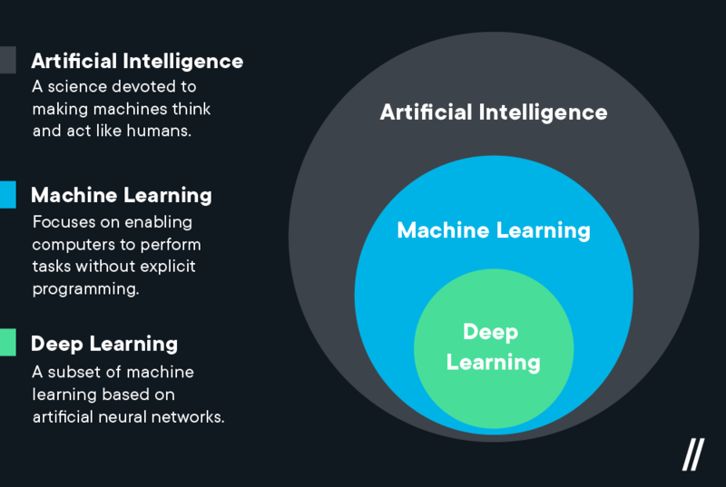
AI, ML and DL

Slide 7

Human can learn from past experience and make decision of its own
7

Slide 8
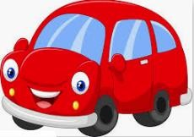
What is this object?
8

Slide 9
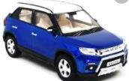

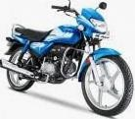
What is this object?
CAR
CAR
BIKE
It is a CAR
BIKE
9

Slide 10
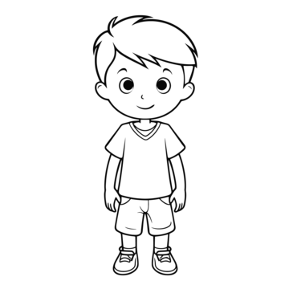


Let us ask the same question to him
?
What is this object?
10

Slide 11
[ But, he is a human being. He can observe and learn ]

Slide 12

Let us make him learn
CAR
show him
CAR
BIKE
BIKE
12

Slide 13

Let us ask the same question now
CAR
What is this object?
CAR
CAR
BIKE BIKE

Slide 14

What about a Machine ?
Machines follow instructions
[ It can not take decision of its own]

Slide 15
What about a Machine ?
We can ask a machine
To perform an arithmetic operations such as
  Addition
  Multiplication
  Division
Machines follow instructions

Slide 16
What about a Machine ?
Comparison
Print
Plotting a chart
Machines follow instructions

Slide 17
What is Machine Learning?
[ We want a machine to act like a human]

Slide 18

What is Machine Learning?
[ to identify this object.]

Slide 19
What is Machine Learning?
Price in 2025?
[ predict the price in future]

Slide 20
What is Machine Learning?
I made met him yesterday
[ Natural Language understand, and correct grammar ]

Slide 21

What is Machine Learning?
recognize face
[ Recognize Faces ]

Slide 22
What is Machine Learning?
[ What do we do?
Just like, what we did to human, we need to provide experience
to the machine.
]

Slide 23
What is Machine Learning?
[
This what we called as Data or Training dataset
+
So, we first need to provide training dataset to the machine
]
Dataset

Slide 24

What is Machine Learning?
+
+
[ Then, devise algorithms and execute programs on the data
With respect to the underlying target tasks ]
Dataset

Slide 25

What is Machine Learning?
+
+
+
Dataset
[ Then, using the programs, Identify
required rules ]

Slide 26

What is Machine Learning?
+
+
+
Dataset
[extract required patterns ]

Slide 27

What is Machine Learning?
+
+
+
Dataset
[ Identify relations ]

Slide 28
+
What is Machine Learning?
=
+
+
Dataset
[ So that machine can derive inferences
from the data ]

Slide 29


In summary, what is machine learning?
Given a machine learning problem
Identify and create the appropriate dataset
Perform computation to learn
  Required rules, pattern and relations
Output the decision

Slide 30
Machine Learning Paradigms
Supervised
Unsupervised Learning
Reinforcement learning
[ We as human being solve various types of problem in our day-to-day life, Various decisions need to be taken.
Depending on the nature of the problem, machine learning tasks can be broadly divided in ]

Slide 31
What is Supervised Learning?
CAR
+
CAR
₌ Training Dataset
BIKE
BIKE
Samples
Labels
[In supervised learning, we need some thing called a Labelled Training Dataset ]

Slide 32
What is Supervised Learning?
CAR
+
CAR
₌ Training Dataset
𝑓( , )=
BIKE
BIKE
Samples
Labels
[ Given a labelled dataset, the task is to devise a function which takes the dataset, and a new sample, and
produces an output value.]
32

Slide 33

What is Supervised Learning?
CAR
+
CAR
₌ Training Dataset
𝑓( , )=
BIKE
BIKE
Samples
Labels
[ Given a labelled dataset, the task is to devise a function which takes the dataset, and a new sample, and
produces an output value.]
33

Slide 34
What is Supervised Learning?
CAR
+
CAR
₌ Training Dataset
𝑓( , )= CAR
BIKE
BIKE
Samples
Labels
[ Given a labelled dataset, the task is to devise a function which takes the dataset, and a new sample, and
produces an output value.]
34

Slide 35
What is Supervised Learning?
CAR
Classification
𝑓( , )= CAR
+
CAR
₌ Training Dataset
BIKE
BIKE
Samples
Labels
[ If the possible output values of the function are predefined and discrete/categorical, it is called
Classification
33

Slide 36
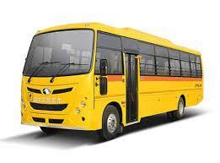
What is Supervised Learning?
CAR
Classification
𝑓( , )= CAR
+
CAR
₌ Training Dataset
BIKE
BIKE
Samples
Labels
[ Predefined classes means, it will produce output only from the labels defined in the dataset. For example,
even if we input a bus, it will produce either CAR or BIKE ]

Slide 37
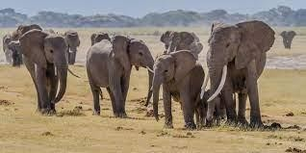
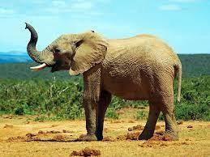
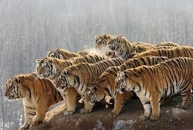
Classifier
Elephant
Tiger
Elephant
Classifier
Identify the Animal ?
Dataset

Slide 38
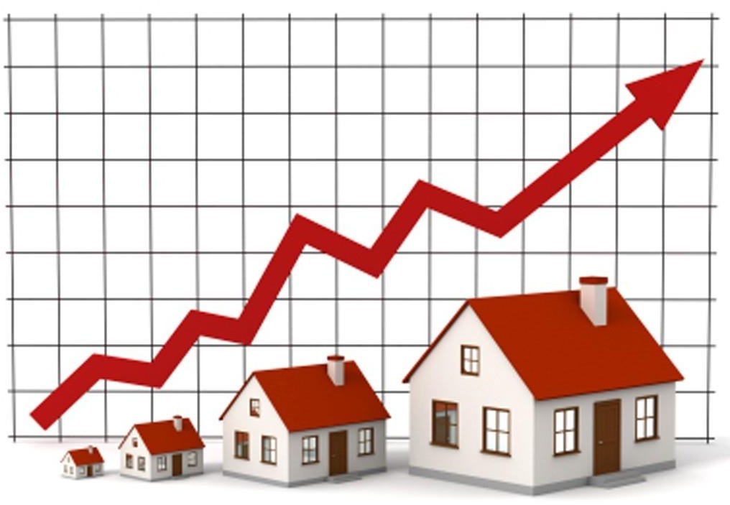
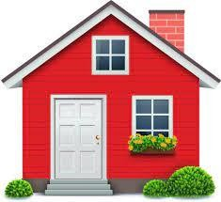
Regression
Regression
𝑓( , )= 20500.50
Dataset
[ If the possible output values of the function are continuous real values, then it is called Regression

Slide 39
[
The classification and Regression problems are supervised, because the decision depends on the characteristics of the ground truth labels or values present in the dataset, which we define as experience
]

Slide 40
What is Unsupervised Learning
CAR
CAR
BIKE BIKE
Dataset
[ In the unsupervised learning, we do not need to know the labels or Ground truth values ]

Slide 41
What is Unsupervised Learning
Clustering
Dataset
[ The task is to identify the patterns like group the similar objects together ]
39

Slide 42

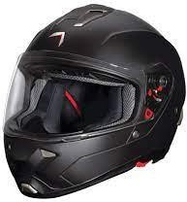
What is Unsupervised Learning
Association Rules Mining
Dataset
[ Association rules like ]

Slide 43
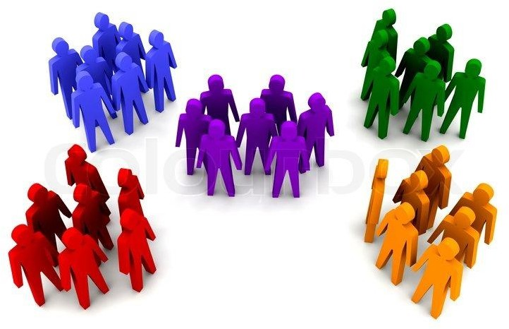
More Example Unsupervised Learning
Dataset

Slide 44
More Example Unsupervised Learning
Dataset

Slide 45


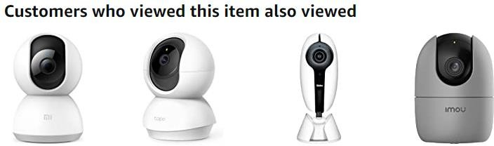
More Example Unsupervised Learning

Slide 46
What is Reinforcement Learning
[ It is also known as learning from trials and errors ]

Slide 47


What is Reinforcement Learning

Slide 48

What is Reinforcement Learning

Slide 49


What is Reinforcement Learning

Slide 50

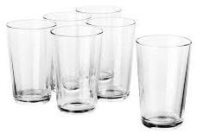




Another Example
Agent
Task
Environment

Slide 51

Reinforcement Learning
Punishment

Slide 52

Reinforcement Learning
Reward

Slide 53
Reinforcement Learning
Reward
Baby Learn from the Trials and Errors
Reinforcement Learning

Slide 54
What is Machine Learning
"A computer program is said to learn from experience E with respect to some class of tasks T and performance measure P, if its performance at tasks in T, as measured by P, improves with experience E.“ (Mitchell Tom 1997)

Slide 55
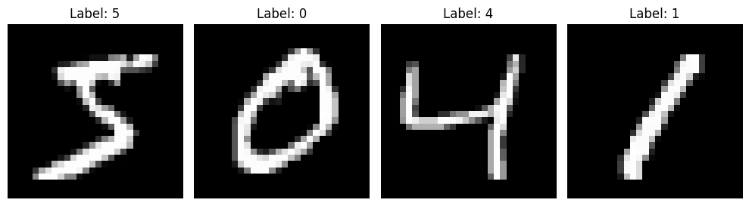
Example
Consider the problem of recognizing handwritten digits

Slide 56
Recognizing handwritten digits
Task T: classifying handwritten digits from images
Performance measure P : percentage of digits classified correctly
Training experience E: dataset of digits given classifications, e.g., MNIST

Slide 57
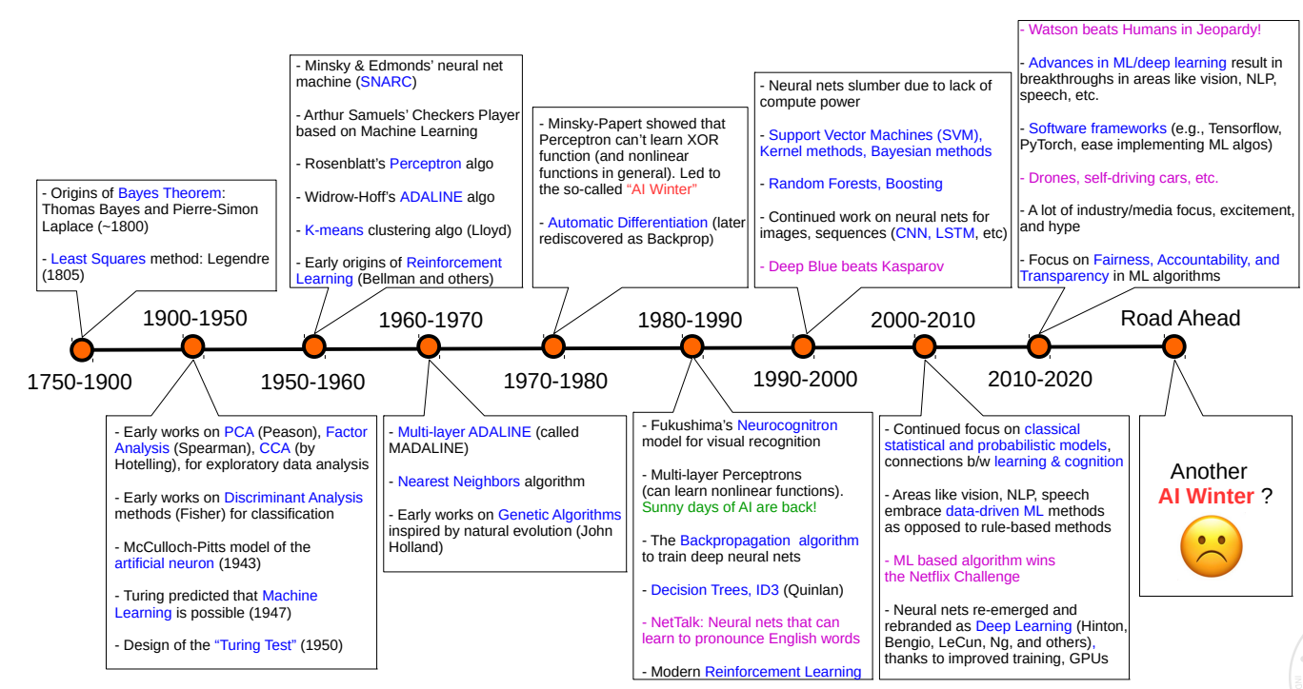
History of Machine Learning

Slide 58
Next Class
Different perspectives of Machine Learning
Data preparation for machine learning models

